Slide 1
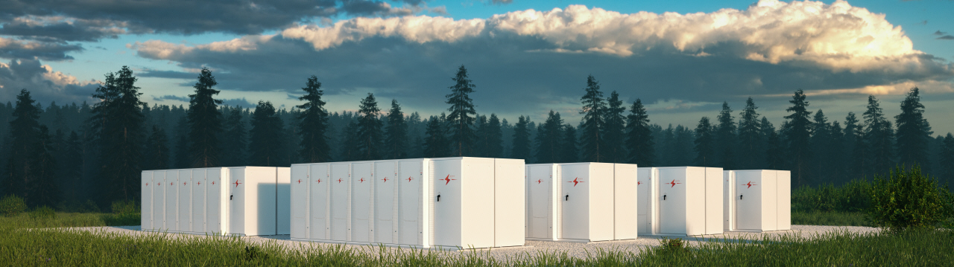
Protecting solar PV with storage – what is the right balance?
An AFRY MCD presentation
November 2024

Slide 2

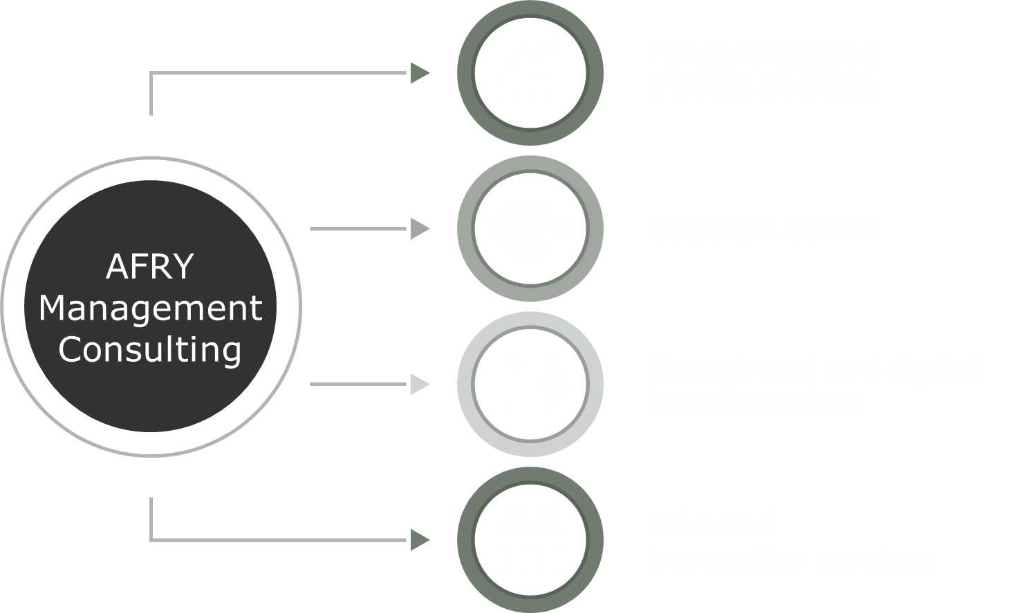
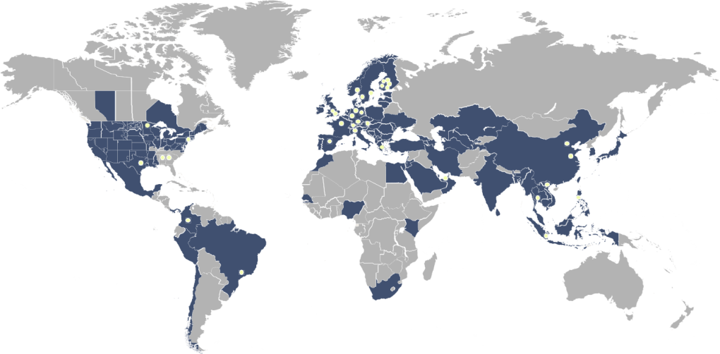
Leading advisor for the transition of the energy and bioindustry sectors
About AFRY Management Consulting
Presence
Net Sales
Projects
Staff
Backed by
5
2.4 billion
>100
800+
19,000
continents
EUR in 2023
countries
management consultants
experts at AFRY
Energy transition
+
Transition to Bioeconomy
Athens, Greece
Newly established office

Slide 3
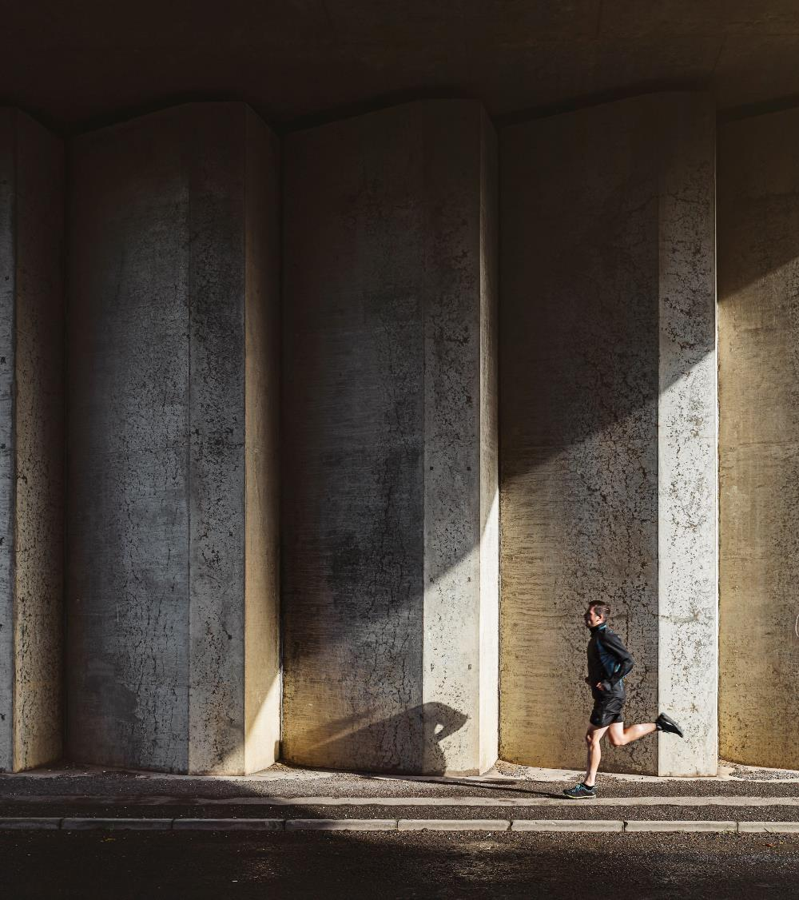
What are we trying to achieve?
Introduction
Questions?
If storage improves solar PV economics and if the opposite is true as well – can one technology fully protect the other?
Does a ‘chicken & egg’ principle apply?
What is the correct balance between the two technologies?

Slide 4

We begin with a rather conservative scenario with regards to solar PV penetration by 2030…
Sensitivity analysis
IMPACT ON SOLAR PV CAPTURE PRICES
Original Capture Price ~ €60/MWh (real 2023)
INSTALLED CAPACITIES (GW)
Solar PV
2hr
4hr
12.0
1.7
1.5
Solar PV
BESS

Slide 5
…We then add 2GW of solar PV and we observe a 20% drop in solar PV capture prices…
Sensitivity analysis
IMPACT ON SOLAR PV CAPTURE PRICES
Original Capture Price ~ €60/MWh (real 2023)
20% drop on Capture Price
INSTALLED CAPACITIES (GW)
Solar PV
2hr
4hr
14.0
12.0
1.7
1.7
1.5
1.5
Solar PV
BESS
Solar PV
BESS

Slide 6
…An additional 1.5GW of 2-hour BESS and 1GW of 4-hour BESS leading to a total BESS capacity of 4.2GW brings capture prices only at 95% of original…
Sensitivity analysis
IMPACT ON SOLAR PV CAPTURE PRICES
Original Capture Price ~ €60/MWh (real 2023)
20% drop on Capture Price
INSTALLED CAPACITIES (GW)
Solar PV
2hr
4hr
14.0
14.0
12.0
1.7
1.7
4.2
1.5
1.5
Solar PV
BESS
Solar PV
BESS
Solar PV
BESS

Slide 7
… Reaching 16GW of solar PV results again in a 20% drop – an extra 2.5W of BESS only brings capture prices to 95% of ‘original’…
Sensitivity analysis
IMPACT ON SOLAR PV CAPTURE PRICES
Original Capture Price ~ €60/MWh (real 2023)
20% drop on Capture Price
INSTALLED CAPACITIES (GW)
Solar PV
2hr
4hr
14.0
14.0
12.0
6.7
1.7
1.7
4.2
4.2
1.5
1.5
2.0
Solar PV
BESS
Solar PV
BESS
Solar PV
BESS
Solar PV
BESS
Solar PV
BESS

Slide 8
…This was solar PV economics 101 – Are BESS economics that simple as well?
Sensitivity analysis
IMPACT ON SOLAR PV CAPTURE PRICES
Conclusion:
Solar PV cannibalisation can be avoided with the right mix of storage.
Original Capture Price ~ €60/MWh (real 2023)
20% drop on Capture Price
INSTALLED CAPACITIES (GW)
Solar PV
2hr
4hr
14.0
14.0
12.0
6.7
1.7
1.7
4.2
4.2
1.5
1.5
2.0
Solar PV
BESS
Solar PV
BESS
Solar PV
BESS
Solar PV
BESS
Solar PV
BESS

Slide 9

…Under our ‘baseline’ assumptions 2-hour BESS gross margins are at 80% of their levelised costs whereas 4-hour are at 100%…
Sensitivity analysis
IMPACT ON BESS GROSS MARGINS
4-hour
Levelised Cost of Storage
2-hour
INSTALLED CAPACITIES (GW)
Solar PV
2hr
4hr
12.0
1.7
1.5
Solar PV
BESS

Slide 10
…Of course, additional solar PV adds to price volatility and hence improves storage economics…
Sensitivity analysis
IMPACT ON BESS GROSS MARGINS
4-hour
Levelised Cost of Storage
2-hour
INSTALLED CAPACITIES (GW)
Solar PV
2hr
4hr
14.0
12.0
1.7
1.7
1.5
1.5
Solar PV
BESS
Solar PV
BESS

Slide 11
…This is where it gets tricky – To reduce solar PV cannibalisation, 2-hour BESS gross margins drop to 60% of their levelised costs…
Sensitivity analysis
IMPACT ON BESS GROSS MARGINS
4-hour
Levelised Cost of Storage
2-hour
60% of Levelised Cost of Storage
INSTALLED CAPACITIES (GW)
Solar PV
2hr
4hr
14.0
14.0
12.0
1.7
1.7
4.2
1.5
1.5
Solar PV
BESS
Solar PV
BESS
Solar PV
BESS

Slide 12
…And now the ‘chicken & egg’ stops – Even with further solar PV additions there is still missing money for 2-hour BESS…
Sensitivity analysis
IMPACT ON BESS GROSS MARGINS
4-hour
Levelised Cost of Storage
2-hour
60% of Levelised Cost of Storage
INSTALLED CAPACITIES (GW)
Solar PV
2hr
4hr
14.0
14.0
12.0
1.7
1.7
4.2
4.2
1.5
1.5
Solar PV
BESS
Solar PV
BESS
Solar PV
BESS
Solar PV
BESS

Slide 13
…There needs to be a balance between solar PV capture price protection (hence economic curtailments & zero prices) and storage profitability
Sensitivity analysis
The big question mark remains – How will storage be delivered (regardless of deployment rate)? Is RES colocation an answer?
IMPACT ON BESS GROSS MARGINS
4-hour
Levelised Cost of Storage
2-hour
60% of Levelised Cost of Storage
INSTALLED CAPACITIES (GW)
Solar PV
2hr
4hr
14.0
14.0
12.0
6.7
1.7
1.7
4.2
4.2
1.5
1.5
2.0
Solar PV
BESS
Solar PV
BESS
Solar PV
BESS
Solar PV
BESS
Solar PV
BESS

Slide 14
What is the optimum BESS capacity I should install when collocating with solar PV?
Optimising RES colocation
OPTIMUM RES & BESS CONFIGURATION
Solar PV & 2-hour BESS
Project IRR (pre-tax, real)
12%
Export
Import & Export
11%
10%
9%
8%
7%
6%
BESS to Solar Capacity Ratio
0.2
0.4
0.6
0.8
1.0
1.2
1.4
1.6
1.8

Slide 15
…A 2-hour BESS with capacity between 40% - 60% of the solar PV plant is optimal…
Optimising RES colocation
OPTIMUM RES & BESS CONFIGURATION
Solar PV & 2-hour BESS
Project IRR (pre-tax, real)
12%
Export
Import & Export
11%
10%
9%
8%
Optimum Configuration
7%
6%
BESS to Solar Capacity Ratio
0.2
0.4
0.6
0.8
1.0
1.2
1.4
1.6
1.8

Slide 16
…Being able to import from the grid improves profitability and increases the overall value to the system…
Optimising RES colocation
OPTIMUM RES & BESS CONFIGURATION
Solar PV & 2-hour BESS
Project IRR (pre-tax, real)
12%
Export
Import & Export
Higher Profitability
11%
IRRs less affected from oversizing when there is ability to import from the grid
10%
9%
8%
Optimum Configuration
7%
6%
Inability to import from the grid means less utilisation when oversizing
BESS to Solar Capacity Ratio
0.2
0.4
0.6
0.8
1.0
1.2
1.4
1.6
1.8

Slide 17




Key conclusions
01
Solar PV cannibalisation is inevitable
To fully offset cannibalisation means high missing money for storage
Long-duration storage is more profitable on a solar dominated system

Slide 18
Key conclusions
02
Colocation can be part of the solution
Sizing optimisation is very important
Ability to import from the grid results in the best balance
01
Solar PV cannibalisation is inevitable
To fully offset cannibalisation means high missing money for storage
Long-duration storage is more profitable on a solar dominated system

Slide 19

Key conclusions
03
Location Location Location…
Need to incentivise the installation at the correct location
02
Colocation can be part of the solution
Sizing optimisation is very important
Ability to import from the grid gives the best balance
01
Solar PV cannibalisation is inevitable
To fully offset cannibalisation means high missing money for storage.
Long-duration storage is more profitable on a solar dominated system

Slide 20



