Slide 1


The need of Flexible assets in Modern Power Systems
Athanassios Dagoumas,
President RAAEY & Assoc. Prof. University of Piraeus
Athens, 31.10.2024

Slide 2
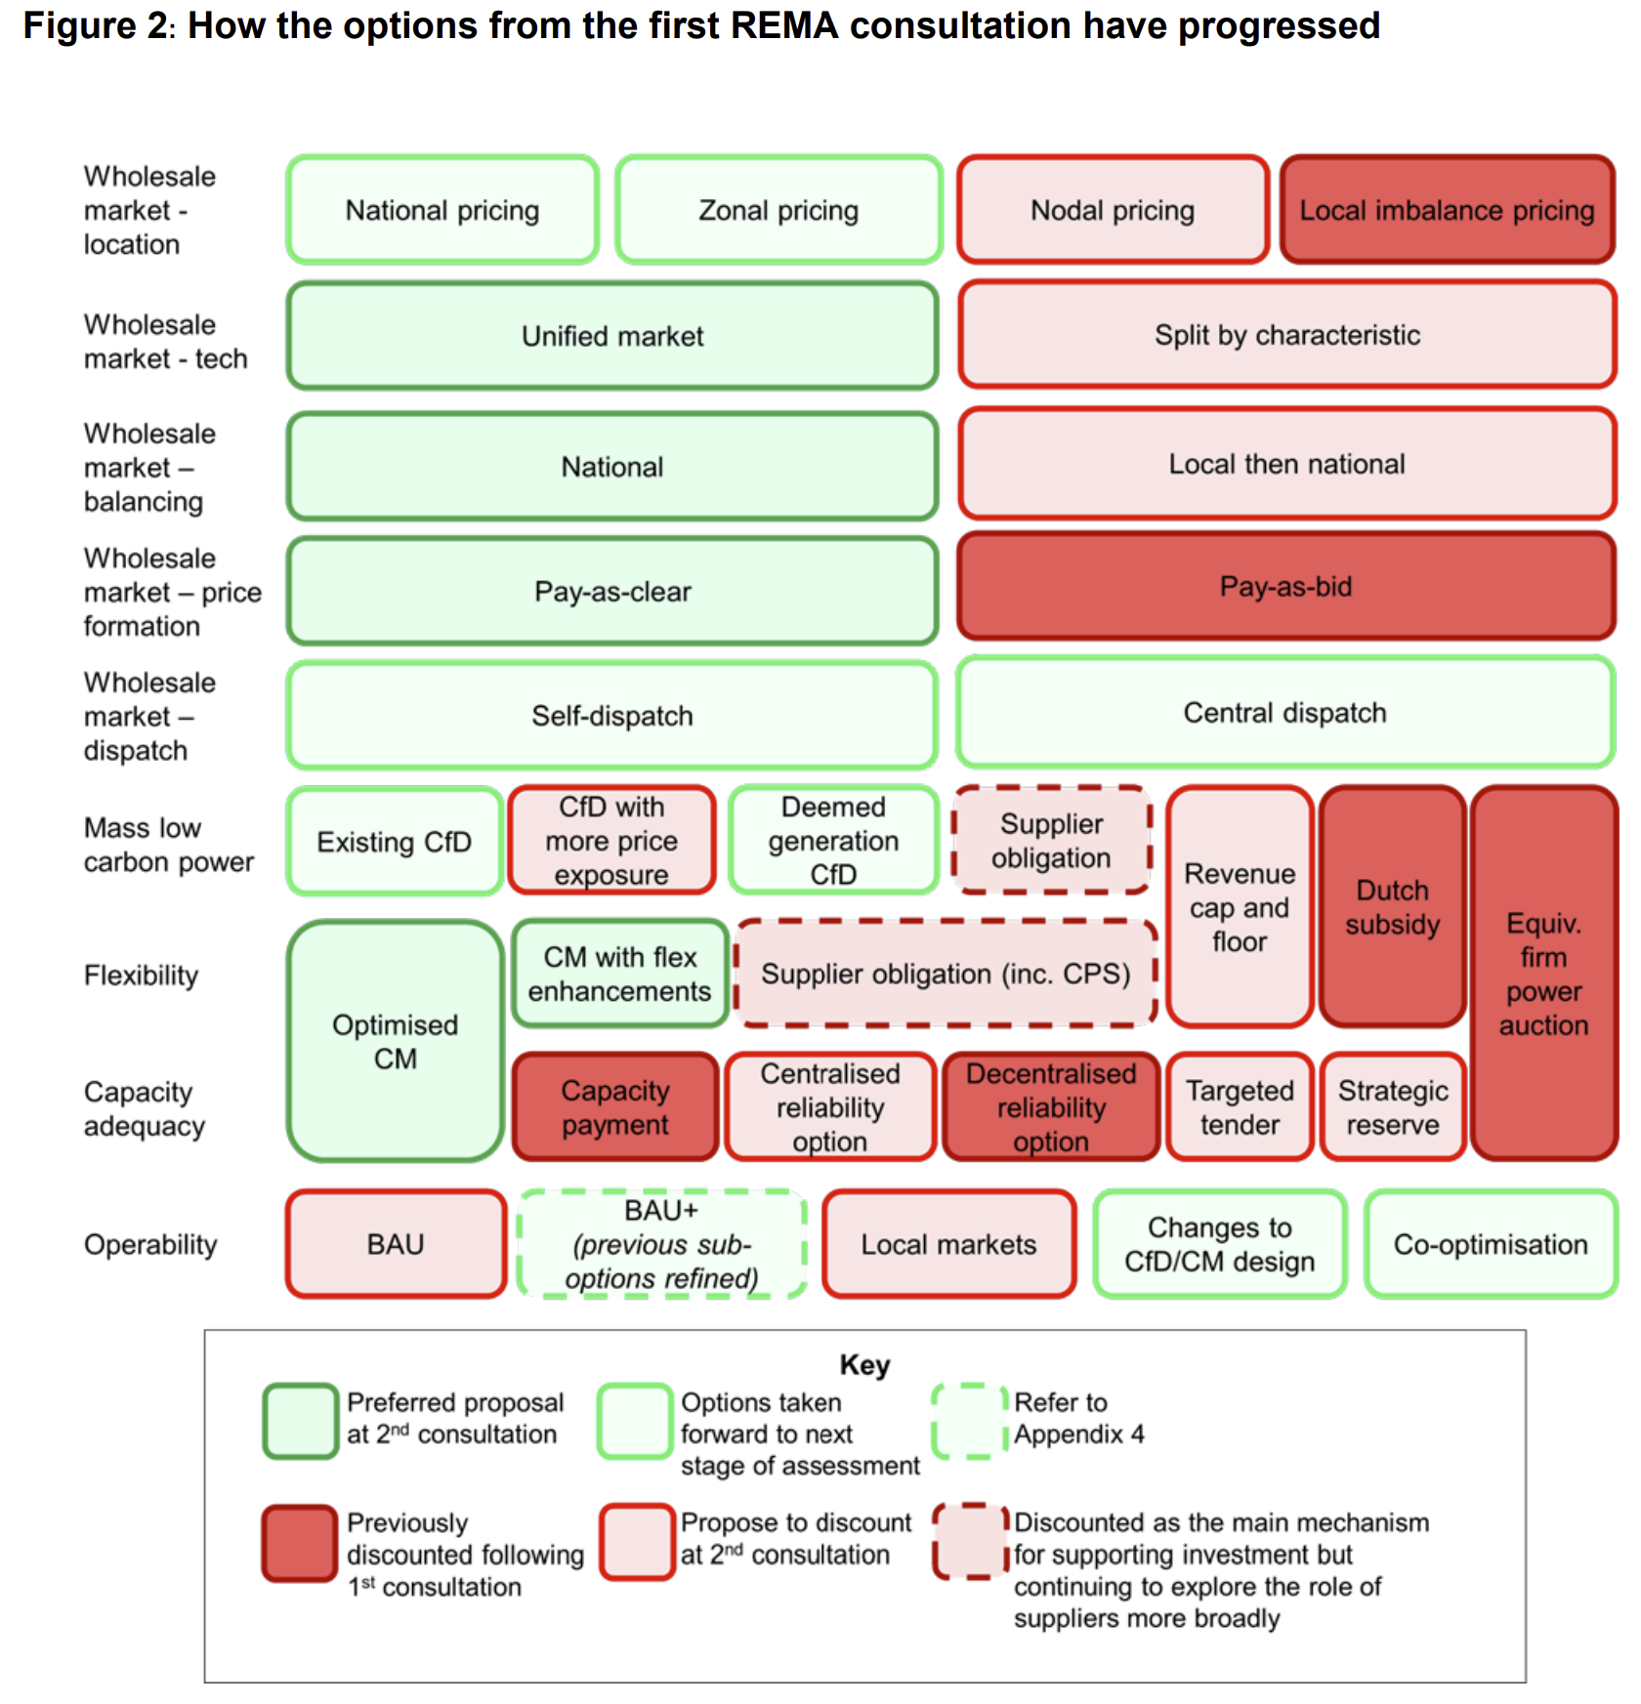
Electricity Market Design in EU in UK
Besides the enhanced Protection to Consumers (during crisis and in normal periods)
Wholesale Market Location
  Zonal pricing retained (nodal not expected to be adopted, besides advantages)
Wholesale Market Technology (split)
  Opt-out in EMD (EU) and in REMA (UK)
  Marginal pricing retained
Wholesale Market Dispatch
  ACER examines Co-optimization of Balancing Capacity Market with Day-Ahead Energy Market (amending the EUPHEMIA algorithm)
Mass Low Carbon Generation
  PPAs and CfD
Flexibility- Capacity Adequacy
  Capacity mechanism to become element of market design (CM with flex enhancement/reliability options seem as preferable options)
Competition
  REMIT update
  Ex-ante power mitigation not adopted
Sources: Review of Electricity Market Arrangements: Options Assessment (REMA), May 2024,
https://assets.publishing.service.gov.uk/media/65ef6694133c220011cd37cd/review-electricity-market-arrangements-second-consultation-document.pdf
M. Keay and D. Robinson, 2017, The Decarbonised Electricity System of the Future: The ‘Two Market’ Approach, Oxford Institute for Energy Studies,
https://www.oxfordenergy.org/wpcms/wp-content/uploads/2017/06/The-Decarbonised-Electricity-Sysytem-of-the-Future-The-Two-Market-Approach-OIES-Energy-Insight.pdf

Slide 3
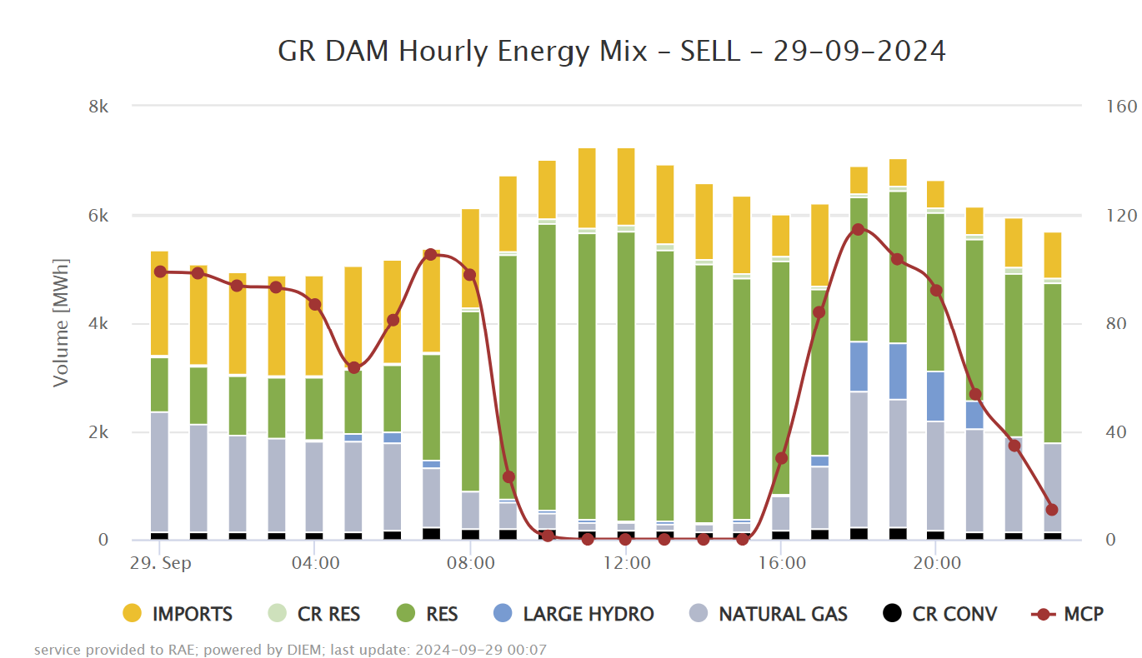
Hellenic Wholesale Electricity Markets Monitoring
Hourly Energy Mix – Day-Ahead Market https://www.rae.gr/en/market-monitoring/greek-wholesale-electricity-markets/electricity-prices-statistics/energymixdam/
Hellenic power system already close to a Modern Power System
(almost) zero prices eliminate energy cost for retailers and consumers,
  however, they create uncertainty in RES projects
  (that could be offset through long-term contracts – CfD and PPAs)
Clear needs for Flexible assets
Price differentials create clear price signal for storage/demand response investments
  Support schemes, CfD, PPAs marketplaces and/or CM supplementary market elements for enhancing investments

Slide 4
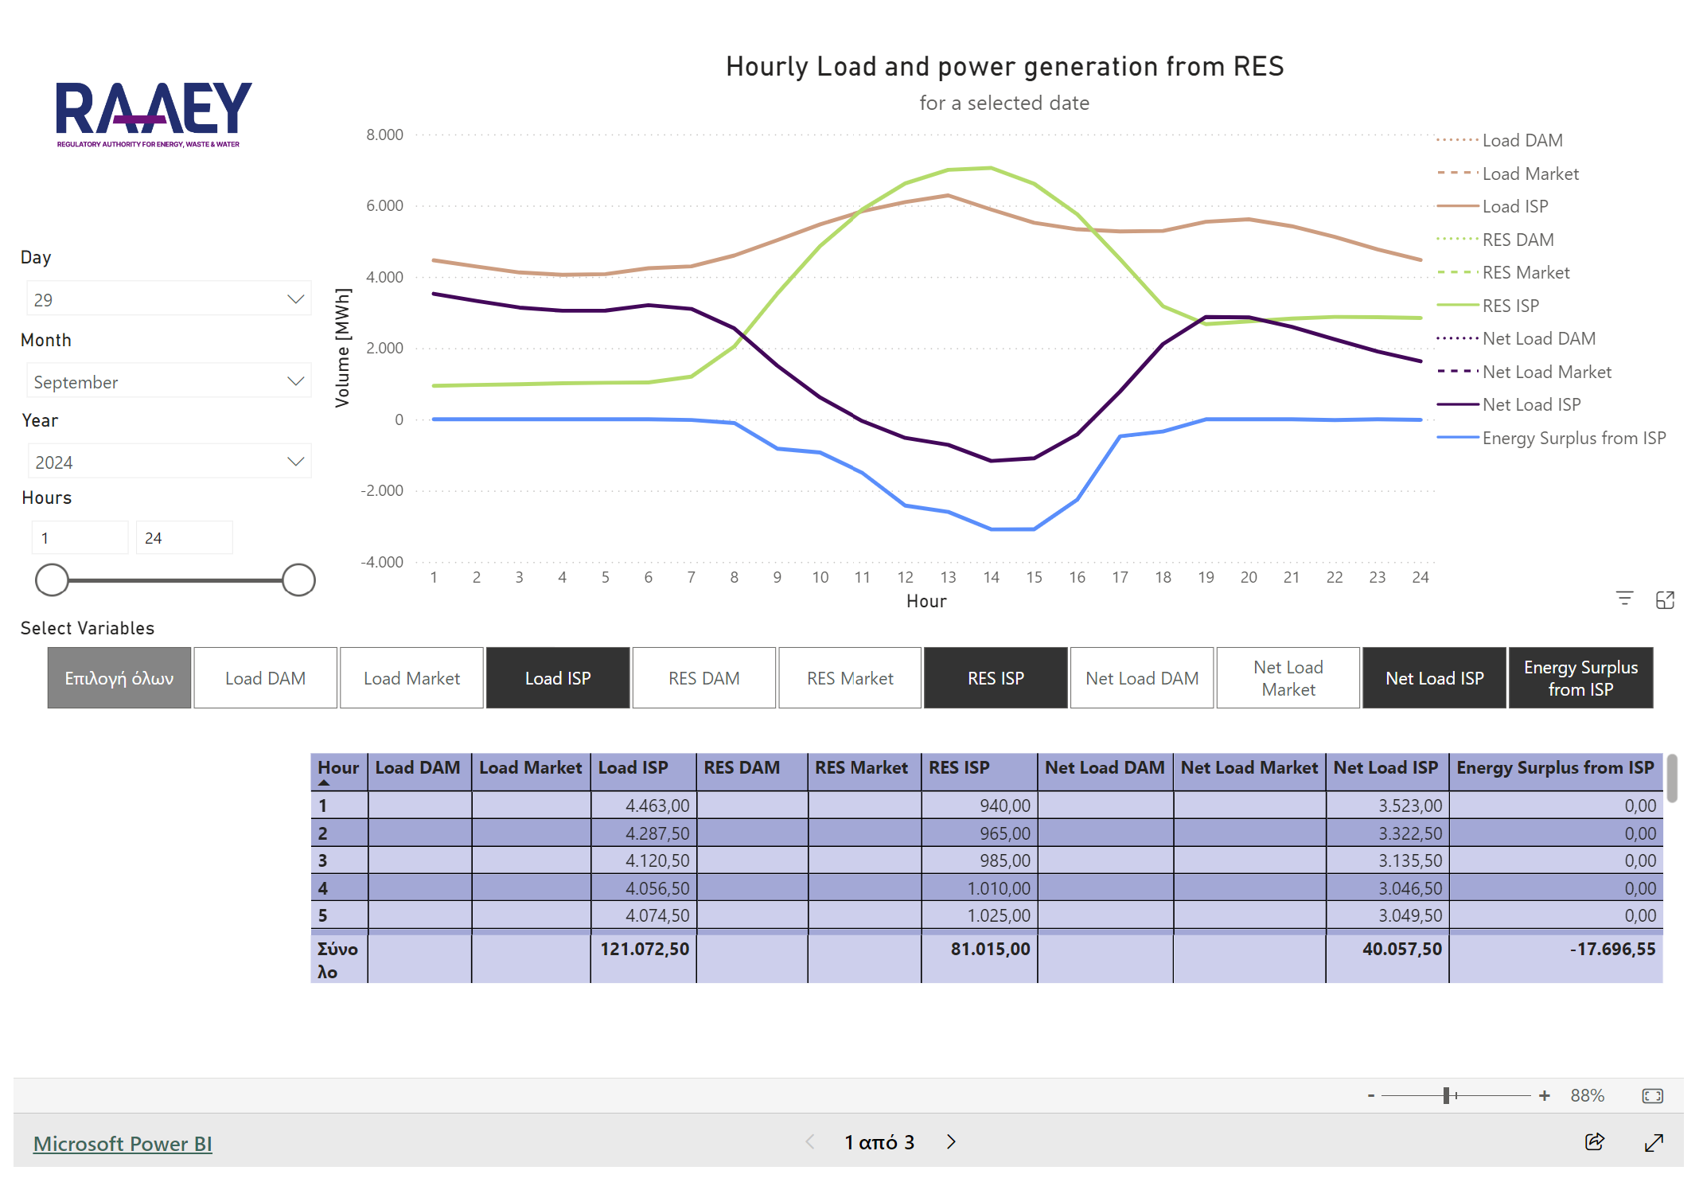
Hellenic Wholesale Electricity Markets Monitoring https://www.rae.gr/en/market-monitoring/greek-wholesale-electricity-markets/electricity-prices-statistics/the-duck-curve/
The Duck Curve
Clear needs for Flexible technologies
(electricity storage, flexible demand, hydrogen-fired generation, power CCUS, electrolysis, SMR(?), interconnections) to respond to RES variations
Electrification of new sectors (EVs, cold ironing, heat pumps, green hydrogen, data centers)
Enhancement of interconnections for system stability and market integration

Slide 5
Main challenge: Competitive RES electricity production pave the way for investments of other technologies
Electricity Storage
Demand Response/Shifting
(19.4, 20.3, 20.5 TWh for residential,
17.9, 19.5, 20.1 TWh for tertiary,
in 2030/40/50 in NCEP)
New electric demand
(gross electric demand:
61.8, 88.4, 130.5 TWh
in 2030/40/50 in NCEP)
Hydrogen
Networks:
Electricity
H2/Gas/Thermal
Data
Batteries
Shifting Industrial Demand
(11.7, 15.9, 16.0 TWh
in 2030/40/50 in NCEP)
Electricity Vehicles
(1.6, 13.7, 24.1 TWh in 2030/40/50 in NCEP)
Not baselload
Green Hydrogen
Development
Pumped Hydro
Smart meters to shift rest Demand
Electrification of Ports (ie Piraeus port: 11 slots - 10 MW each cruise, about 100 MW, hours 7-19)
0.1, 0.4, 0.6 TWh in 2030/40/50)
Green Ammonia/
Methanol
Digitalization
Heat Pumps in Buildings
(4.0, 5.6, 4.4 TWh for residential,
5.8, 7.7, 9.2 TWh for tertiary,
in 2030/40/50 in NCEP)
Hydrogen Storage
Integration
Data Centers
Greece Market size (Power Capacity about 100 MW, potential grow up to 500 MW),
Baseload profile

Slide 6
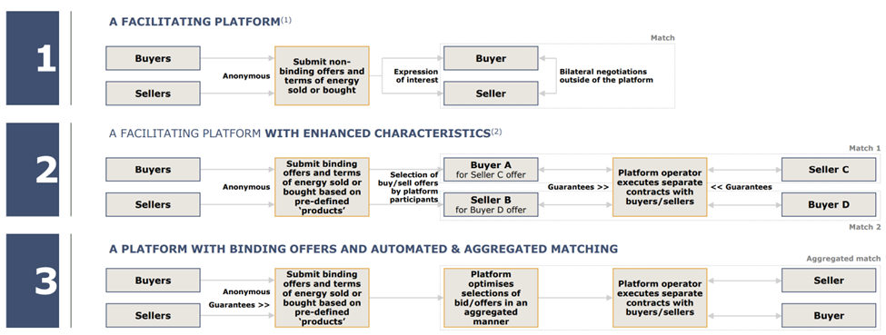
Basic design options of the under implementation
PPAs platform in Greece to enhance low carbon and Flexibility assets
(https://www.rae.gr/wp-content/uploads/2022/11/AFRY-Report_PPA-Platform.pdf)

Slide 7
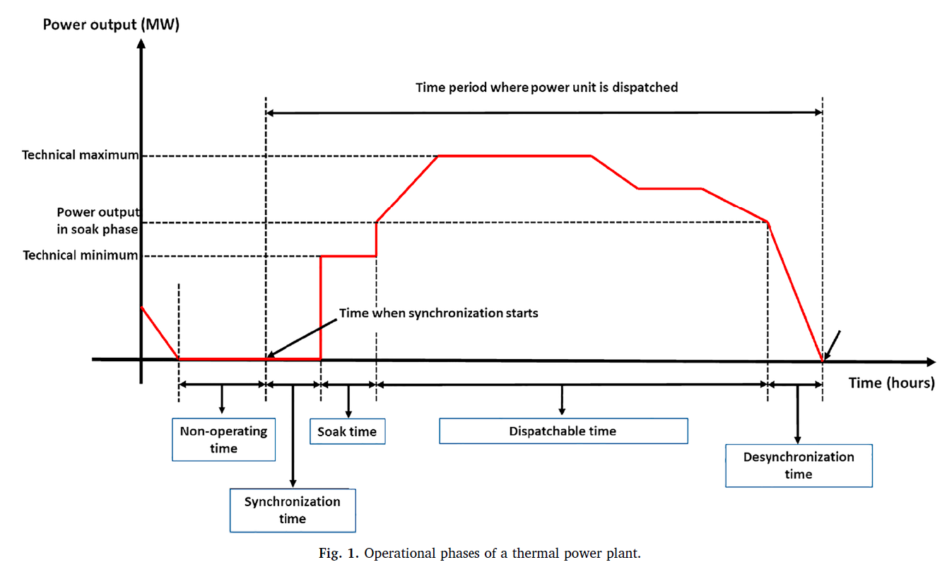
Critical characteristics for Flexible assets in Modern Power Systems
Ramping Capacity, Synchronization & Soak time, Desynchronization time, Technical Minimum
Athanasios S. Dagoumas, Nikolaos E. Koltsaklis, 2019, Review of models for integrating renewable energy in the generation expansion planning, Applied Energy, Vol. 242, pp. 1573-1587 https://doi.org/10.1016/j.apenergy.2019.03.194

Slide 8
Market/technology developments identify the need of Flexible Assets in Modern Power Systems
Market developments
TSO-DSO coordination (reserves procurement, unlock flexibility resources)
  TSOs to join MARI-PICASSO platforms
Interconnections enhancement
Market coupling with Energy Community Contracting Parties
Potential adoption of co-optimization (examined within ACER)
Penetration of Flexible and Low carbon generation enhanced through
Clear price signals from market
CfDs, Support schemes for enhancement of Flexible Assets
Potential implementation of CM
PPAs platform for enhancement of RES/hybrid/storage assets
Electrification of sectors (EVs, cold ironing, heat pumps, green hydrogen, data centers)
Critical characteristics for Flexible assets in Modern Power Systems
Response time
  Ramping Capacity
  Synchronization time, Desynchronization time
Duration (Soak time, Technical Minimum)
Location

