Slide 1

Energy Storage Systems
From Balancing Market to optimization between markets – Commercial operation of storage assets.
Gerasimos Takis-Defteraios, Head of Intraday Trading
Renewables & Storage Forum, November 2024

Slide 2
How do you operate a multimillion asset in energy markets?
with technical constraints
without humans?_

Slide 3
Market structure
In Greece, energy storage assets will operate within a competitive electricity market with high renewable integration.
Key revenue streams
Energy Trading
Wholesale markets*
*Day-ahead market, Intraday markets, Continuous intraday market
Upward and downward FCR
Battery
Reserve Products
Upward and downward aFRR**
**Markets are open to asymmetrical product structure
Upward and downward mFRR**
Upward and downward aFRR Balancing Energy
Energy Products
Upward and downward mFRR
BESS landcape Asset revenues Cross-market optimization Our operations Why us

Slide 4
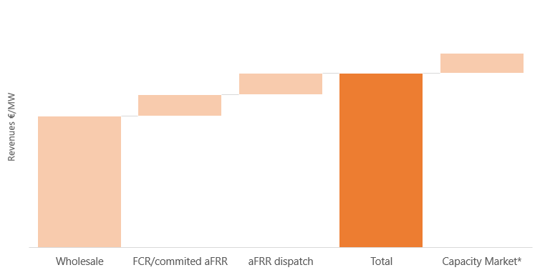
Revenue stack underpinned by arbitrage
The value pool of Battery Energy Storage Systems (BESS) acts as a hedge against cannibalization.
Indicative revenue breakdown
How a BESS makes money
The phase-out of coal and the expansion of renewable energy sources (RES) will increase the demand for system flexibility.
ID volumes will continue to be driven by increasing RES forecast errors
The demand for ancillary services is projected to stay stable
Capture increase volatility in wholesale market – buy low and sell high strategy
Provide capacity to ancillary markets to support system stability
Continuously re-optimize BESS positions in real time using algos
Enable cross-market optimization to maximize revenue across these markets.
*Potential CM revenue upside depending on market design
BESS landcape Asset revenues Cross-market optimization Our operations Why us

Slide 5
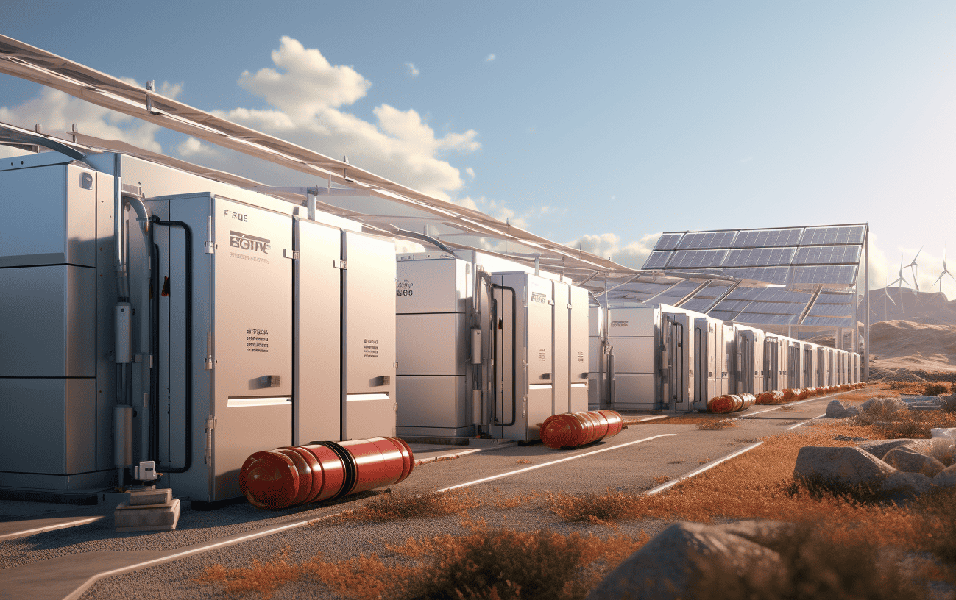
Value stacking
Let’s dive into the diverse benefits that BESS can gain from participating in various markets. Each market offers unique advantages and specific requirements.
1. FCR
3. aFRR
Permanent activation within medial SoC range
Relatively big market compared to FCR
Separated capacity and energy market
Cycle-saving strategies
SoC-management optimization
Highly lucrative activations
2. Wholesale
Arbitrage trading
Low restrictions
Rising market volumes
BESS landcape Asset revenues Cross-market optimization Our operations Why us

Slide 6
Complexity of cross-market optimization
Cross-market optimization for BESS is highly complex, requiring sophisticated algorithms, real-time data analysis, and a deep understanding of diverse market dynamics to maximize returns and efficiency.
Arbitrating and stacking revenues throughout the day
WS
FCR
BESS Optimization
WS
FCR
WS
WS
FCR
aFRR
aFRR
complexity
00h
4am
8am
12am
4pm
8pm
24
Single market Multiple markets
Benefits:
- Stronger optimization, leveraging P&L
- Risk mitigation against cannibalization
- More efficient SoC management
Challenges:
- Complex optimization and dispatch tools
- Real-time (sec by sec) connectivity
- Complex SoC management strategy
Historic prices Forecasted prices
BESS landcape Asset revenues Cross-market optimization Our operations Why us

Slide 7
Asset in action
A BESS asset can participate in multiple markets in a single day, dynamically switching between services to maximize revenue and enhance grid stability. Effective state of charge (SoC) management is crucial to optimize performance and meet market demands.
symmetric FCR commitment
Fully charged
DAM IDA XBID Sell Buy
Wholesales and FCR continuously re-optimized within the current day
BESS landcape Asset revenues Cross-market optimization Our operations Why us

Slide 8




Optimus Energy operations
Key in-house developments in combination with prosperous partnerships have propelled our success so far. Optimus Energy provides the maximum added value to your asset.
Business Development
Optimizer
RES Plants
Flexible assets
Industrial load
BESS
Optimus Energy Trading Room
Forecasting
Trading
VPP
RES, load
Internal models & tools
Short-term trading
Ancillary services
RES
Load
BESS
BESS landcape Asset revenues Cross-market optimization Our operations Why us

Slide 9





Our optimization close-up
Optimus Energy has developed advanced operations tailored to optimize Battery Energy Storage Systems (BESS), leveraging cutting-edge algorithms and real-time data analysis to seamlessly navigate and maximize returns across multiple energy markets.
ETRM
Bids Executions
Settlement
Optimization Suite
Optimization
Machine Learning
AI
Heuristic Rules
Auto Bidder
Create Bids
Platforms
Position
Bidding
DB
API
External
Data Sources
Orderbook
Cleared Prices
Cleared Quantities
etc
Market Analysis
BESS landcape Asset revenues Cross-market optimization Our operations Why us

Slide 10







Ensuring your success in the market
Optimus Energy is the #1 renewable energy aggregator in Greece, with a portfolio of more than 3.6GW. Since its foundation, the company paved a remarkable journey, achieving a clear lead over its competitors.
Cross market optimization
We capitalize all market phases with tailor-made optimization tools
Transparency
100% transparency: access to real-time customer portal
Respecting asset constraints
We respect your warranties, and we consider BESS degradation in our optimization
Customer-centricity
We continuously discuss with you to identify improvements on our strategy
Experience
We have the most volumes in the intraday continuous market in Greece
We are tech savvies
We use algos and automation in most of our processes
BESS landcape Asset revenues Cross-market optimization Our operations Why us

Slide 11

Thank you
Join the largest renewable energy aggregator and demand response services provider in Greece.

