Slide 1
PPA Platform
Athens | Thursday, 31st of October 2024
Manolis Kalaitzakis
Strategy and Business Development Director
Hellenic Energy Exchange S.A.
#6
Renewable & Storage Forum

Slide 2


PPA Platform | The Market
The HEnEx PPA Platform provides a marketplace for PPA buyers and sellers to meet
Both Buy and Sell offers can be posted on the PPA Platform
Parties may express their interest in an offer
A template contract with standard general terms & conditions will be available on the platform for interested parties to use

Slide 3
PPA Platform | Eligible Participants
Who is eligible to become a
Participant?
Participants can be:
  Producers and RES Producers
  Suppliers
  Traders
  Aggregators
  Self‐Supplying Consumers
  Final Consumers
  HEnEx aims to provide equal access to all market players

Slide 4
PPA Platform | Offers and Expressions of Interests
PPA Platform | Timeline: Offers and Expressions of Interest
Submit an Offer
Review of Offers Table
Negotiate (outside the platform)
Express an Interest in an Offer
Sign a contract (outside the platform)
Record the new Contract (optional)
Platform members may post non-binding Buy and Sell PPA Offers, by customizing a selection of commercial terms. Commercial terms are standardized through drop-down menus.
Offers are displayed anonymously in the Offers Table.
Participants have the option of expressing interest in an offer, having the option to indicate a selection of terms they would like to negotiate.
Upon the expression of interest, the identity of the interested party is revealed to the member that originally submitted the Offer which may accept or reject the expression of interest.

Slide 5
PPA Platform | Negotiations and contract conclusion
PPA Platform | Timeline: Negotiations and contract conclusion
Submit an Offer
Review of Offers Table
Negotiate (outside the platform)
Express an Interest in an Offer
Sign a contract (outside the platform)
Record the new Contract (optional)
Following an acceptance of an expression of interest, identities are revealed throughout and the two parties (buyer and seller) can contact each other and use the offer submitted in the PPA Platform as the basis for negotiation.
Upon successful negotiations, the parties proceed with signing a PPA contract bilaterally, outside the PPA Platform.
A template contract is available in the platform for the parties to use (optional).
In case of contract conclusion, the seller has the option to proceed to the recording of the contract in the PPA Platform, by filling out a form with mandatory and optional fields.

Slide 6
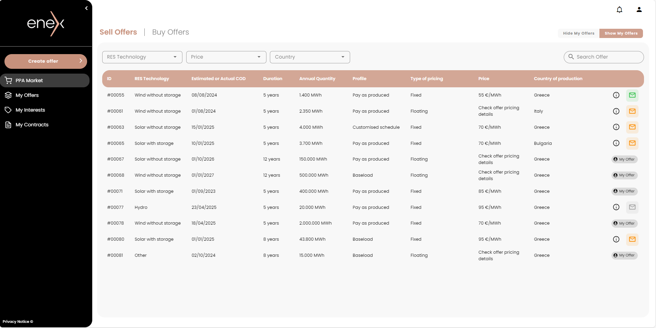
PPA Platform | PPA Market section
PPA Platform | PPA Market section

Slide 7
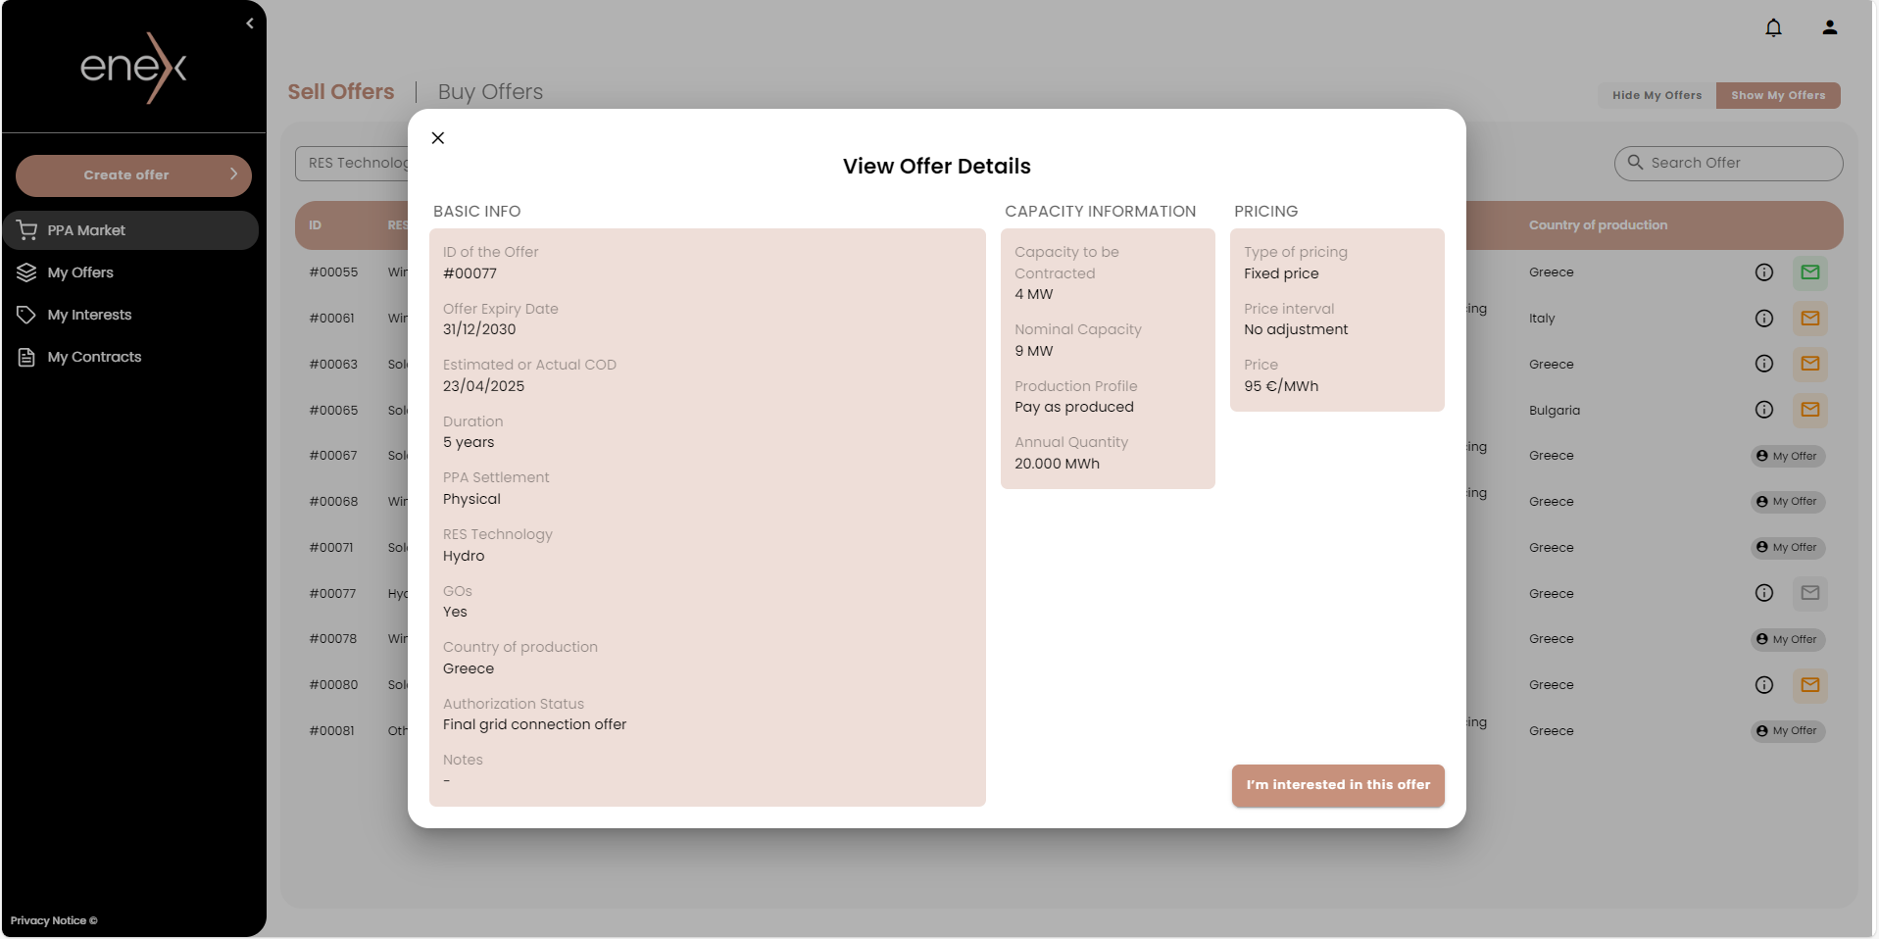
PPA Platform | Expression of interest in an Offer
PPA Platform | PPA Market section: Expression of interest in an Offer

Slide 8
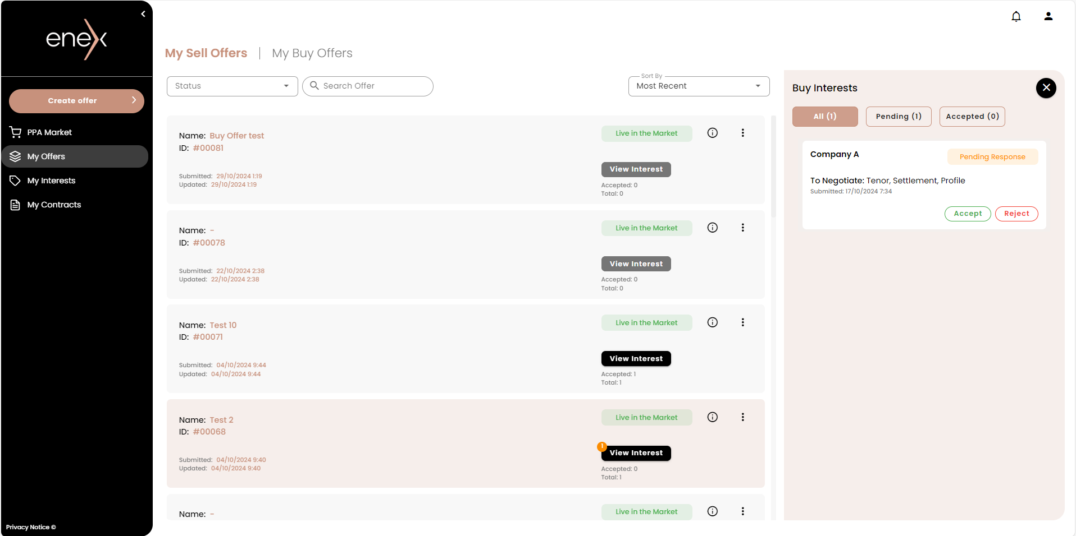
PPA Platform | My Offers section
PPA Platform | My Offers section

Slide 9
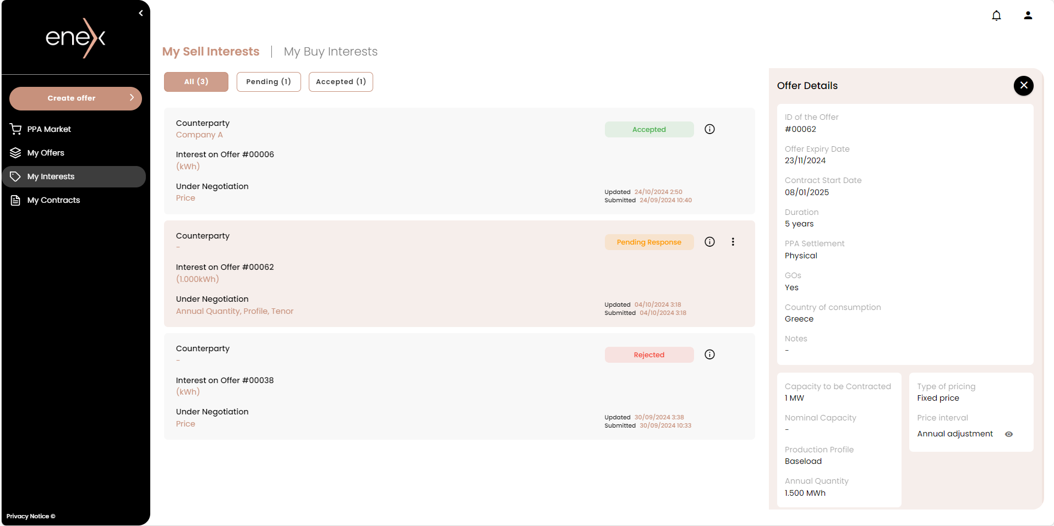
PPA Platform | My Interests section
PPA Platform | My Interests section

Slide 10

PPA Platform | Next steps
PPA Platform | Next steps
Public consultation on the PPA Platform Rulebook and HEnEx Technical decisions which cover admission, operation, and pricing issues
HEnEx Workshop
Onboarding process
Go-live of the PPA Platform

Slide 11
Thank you for your attention
Manolis Kalaitzakis
Strategy & Business Development Director, HEnEx
Strategy&BusinessDevelopment@enexgroup.gr

Slide 12
PPA Platform | The Benefits
Market Familiarization
Equal Access
Market Trust
Price Transparency
Notes:
An HEnEx offering is positioned to contribute to increasing market know-how and experience
HEnEx can provide equal access to all market players, irrespective of their size, while maintaining fees at a low level
HEnEx can leverage its reputation and credibility with the domestic energy market to create and offering that the PPA ecosystem stakeholders can trust
HEnEx is at a unique position to provide market/price transparency through the publication of relative indices

Slide 13
PPA Platform | PPA market timeline
PPA Platform | PPA market timeline
Submit an Offer
Review of Offers Table
Negotiate (outside the platform)
Express an Interest in an Offer
Sign a contract (outside the platform)
Record the Contract (optional)
Offer Submission & Interest Expression Section
  Contract Recording Section
  Operating Schedule:
  All functionalities of the PPA Platform operate continuously throughout the year

