Slide 1
Jinko ESS Europe
About Jinko ESS
www.jinkosolar.eu/ess

Slide 2

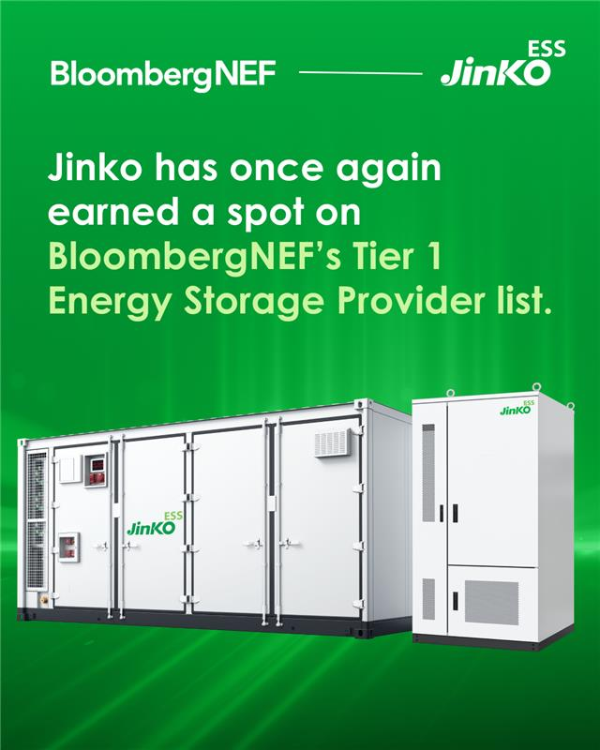
About Jinko ESS
Jinko ESS, is a strategic arm of Jinko Solar, and aims to become one of the world's leading energy storage solutions providers, specifically designed for commercial, industrial and utility applications.
Jinko ESS has once again secured its position on BloombergNEF Tier 1 Energy Storage list in Q4 2024.
PV ModuleTech Bankability Ratings. Jinko Solar has been ranked in the highest 'AAA' category in the Q2 2024 release of PV-Tech’s ModuleTech bankability report.
www.jinkosolar.eu/ess
Jinko ESS Europe

Slide 3
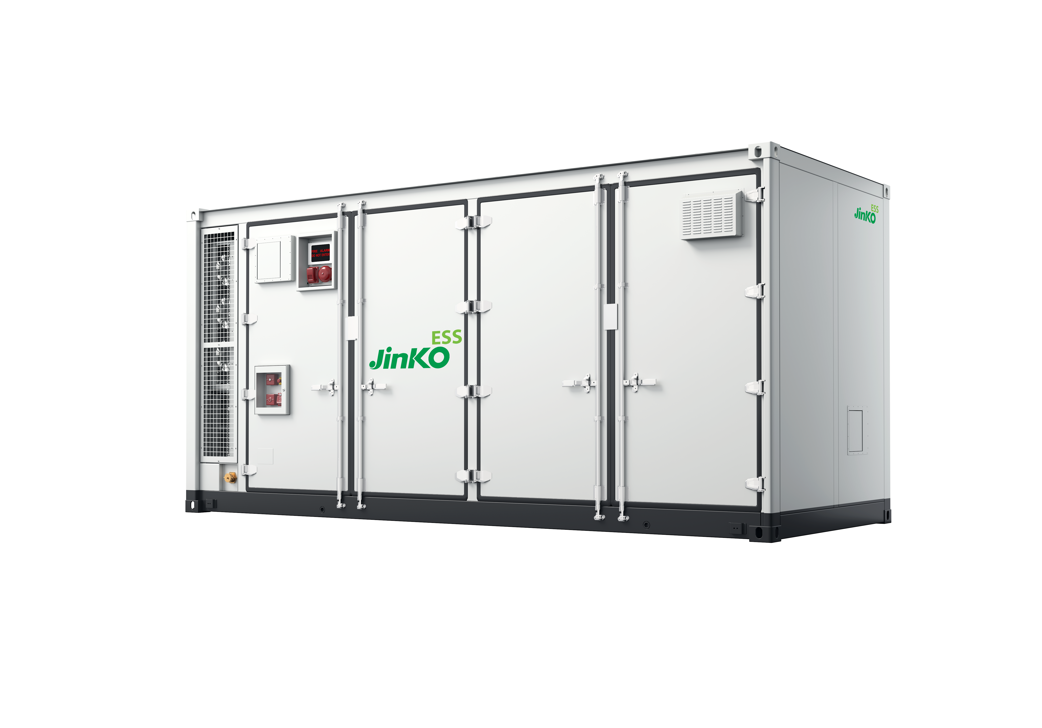
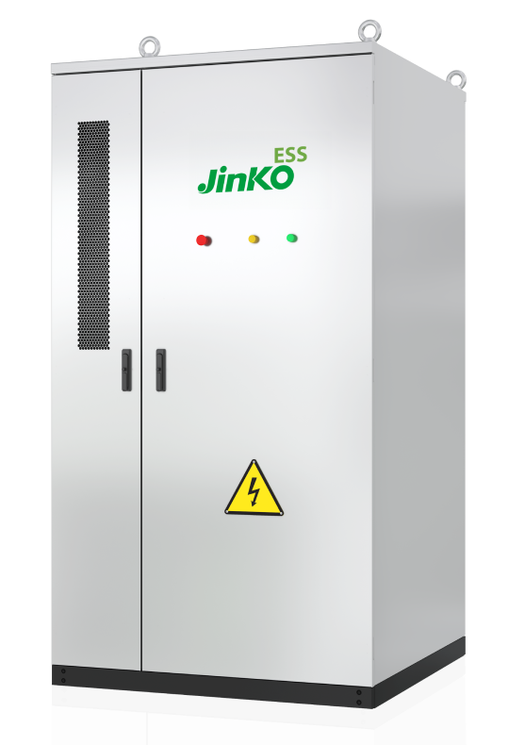
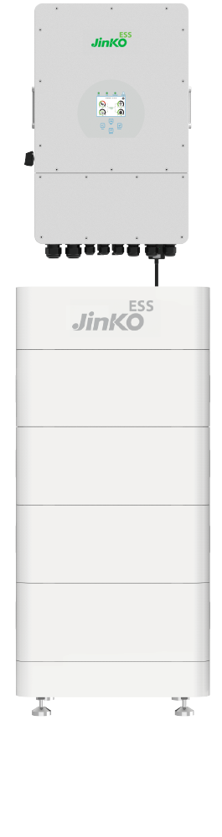
Jinko ESS
Energy Storage Systems
SunTera
Utility Energy Storage System
SunGiga
Commercial & Industrial
Storage System
Residential Energy
Storage Systems
www.jinkosolar.eu/ess
Jinko ESS Europe

Slide 4
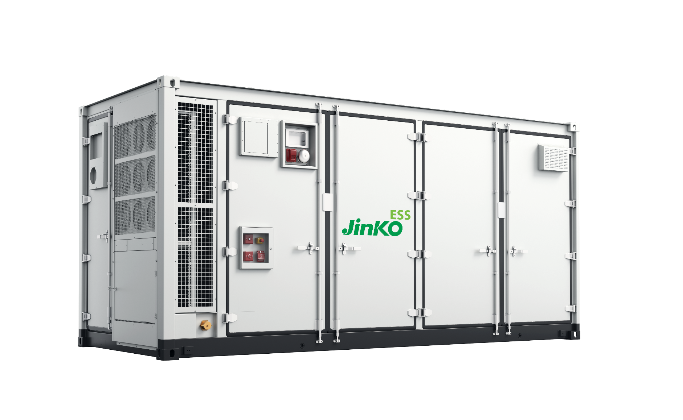
SunTera 5.01 MWh Utility
Scale Battery System
www.jinkosolar.eu/ess
Jinko ESS Europe
DC <1500V System​​
Cell Type
Lithium Phosphate Prismatic
Normal capacity
5 MWh (2 hours optimized)
Voltage range
1075V~1382V​
Cooling concept
Liquid Cooling​​
Operating altitude
≤2000m / <4000m (optional, derating)
IP level
IP55
Fire safety
Aerosols /Novec 1230 / Dry pipe
Anticorrosion grade
Up to C5
Dimensional footprint
20 feet (6 meter) container
Weight
≈42000kg​

Slide 5
www.jinkosolar.eu/ess
Jinko ESS Europe
European Focused Service
Delivery Complete Storage Solution
Including engineering, supply, delivery, commissioning, After-Sales Support, Service & Maintenance of BESS, PCS (Power Conversion System), MV Skid transformer and EMS (Energy Management System). Customized Solution.
Full lifecycle support
In-house Technical Engineering team for commissioning and optimizing system performance.
Product specific training and engineering support provided to clients.
Customizable Service & Maintenance plans tailored to the project.
Warehouses
Distributed across Europe to cut down on delivery times when it matters most.
Spare parts and batteries stored locally.
Logistics
European based logistics team working hand in hand with customers to streamline operations.

Slide 6
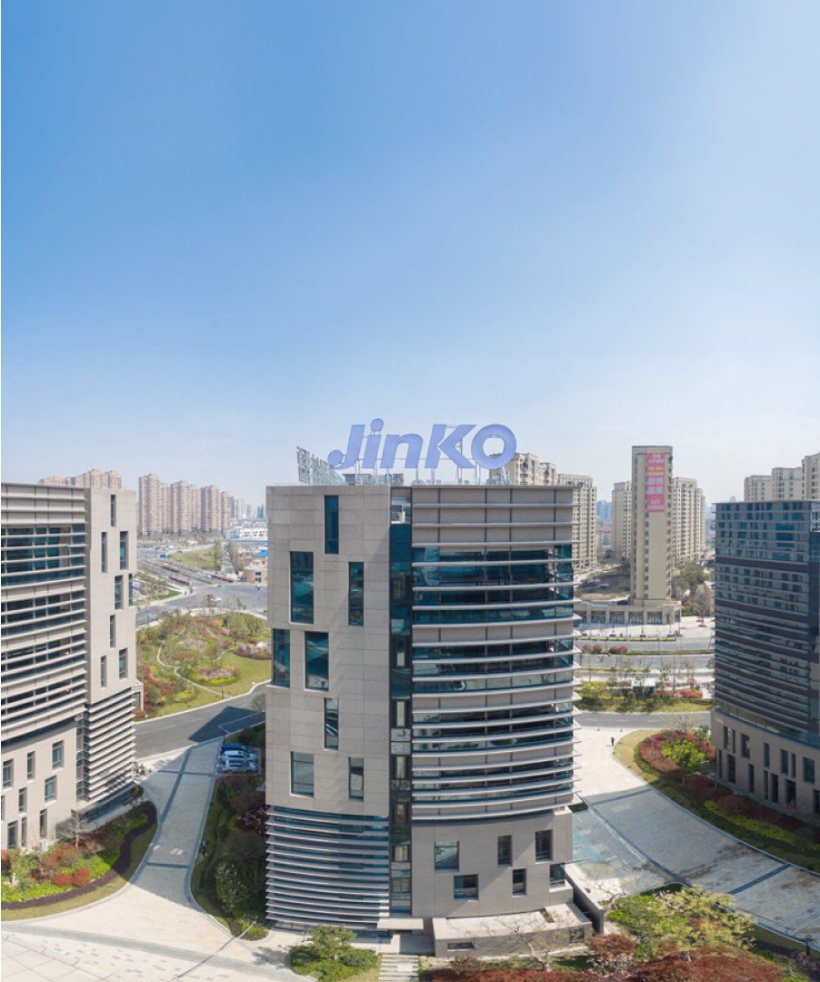
Updated April 2024
Thank you for your attention
For any questions, clarifications or other informations,
please contact:
For utility & industry storage
bess.eu@jinkosolar.com
Presenter:
Lawrie Wilson
European Sales Manager BESS lawrie.wilson@jinkosolar.com
www.jinkosolar.eu/ess
Jinko ESS Europe

