Slide 1


Thierry Pollet
Energy sector executive
Huawei
Panel: Technological developments and equipment costs in photovoltaics, wind, and storage
Athens, November 1st, 2024.

Slide 2

Technological developments in battery storage: Grid Forming (GFM)
(enabling PV integration, Grid stability, Merchant market grid services)
1st November 2024, Athens

Slide 3

Thierry Pollet
Energy Sector Executive | Innovator | Power Digitalization
Results-driven transformation leader with 20+ years of experience in innovation management, product management and R&D management for ICT and energy industry.
Successfully developed delivered new products and services to leading companies such as Nokia, Toshiba (L+G), ABB.
Digital transformation lead Hitachi Energy systems BU
Leading role in internal and external startups capitalizing on emerging market opportunities.
Leading world’s first products in high speed internet (xDSL), distribution network state estimation (PMU), digital twins of power stations

Slide 4

1.
Greek Electricity System
2.
Challenges for large scale RES integration
3.
Grid Stability
4.
New merchant market services (FFR, Inertia)
5.
Grid Forming through battery storage systems
6.
Regulation and standards
7.
Summary & conclusion

Slide 5
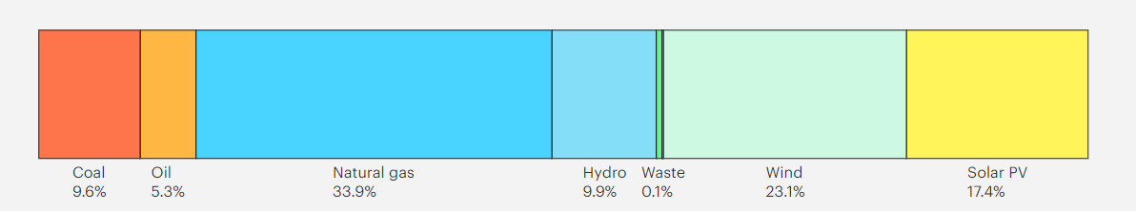
Greek Electricity System
Electricity Generation 2023*
48TWh**
34% Natural gas
23% Wind
17% PV
Installed Capacity: 24.1 GW
PV capacity (GW)
13.4
7
5.5
2023
2024
2030
*source: https://www.iea.org/
**11% imports

Slide 6
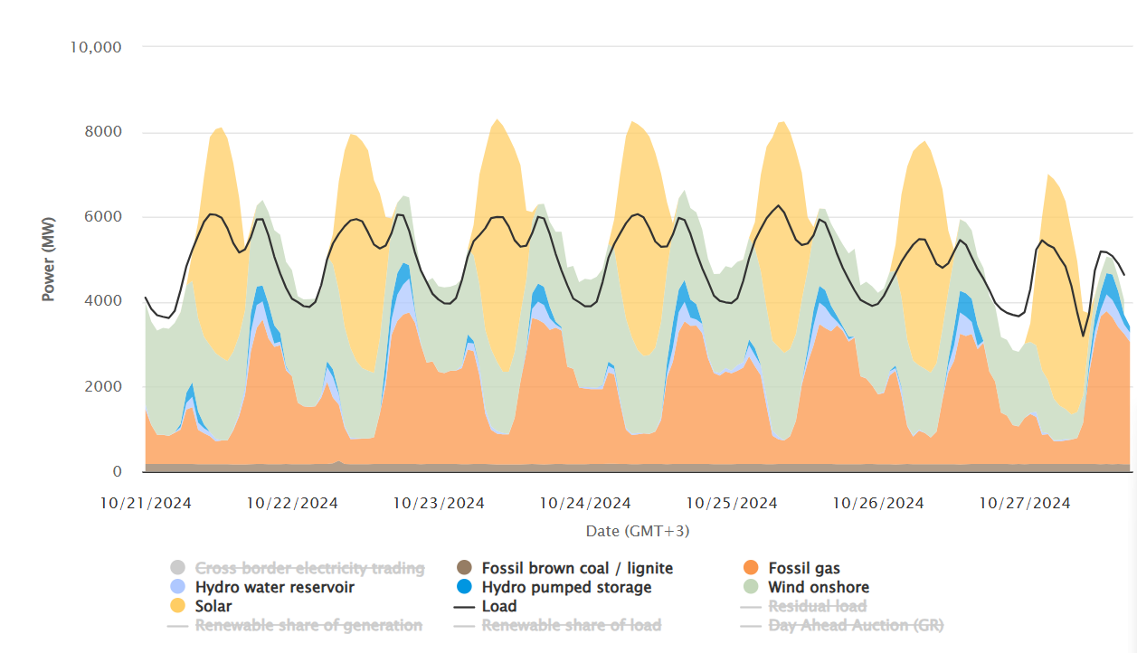
Electricity Demand – Generation Balance
Net electricity generation in Greece, week 43, 2024*
230
Characteristics
Unbalance
Curtailment
Price volatility
Grid Capacity
Price (Euro/MWh)
115
0
Day-ahead price
*source: www.energy-charts.info

Slide 7
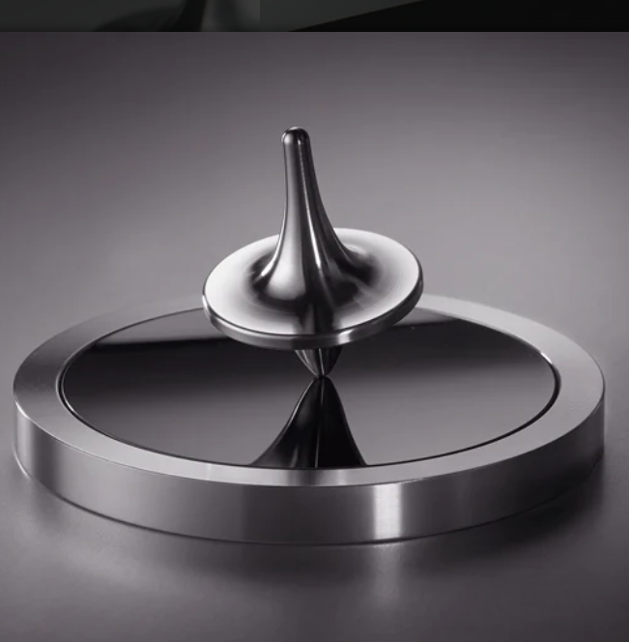




Grid stability – inertial response
Grid frequency is determined
by Inertia H and power unbalance
F
m
r
x
$T$_{m}
$$θ$$
$T$_{e}
Electrical Power
Inertia constant [s]
Mechanical Power
$$2H\frac{d\overline{ω}}{dt}={\overline{P}}_{m}−{\overline{P}}_{e}$$
Grid frequency
source: foreverspin
T=torque

Slide 8

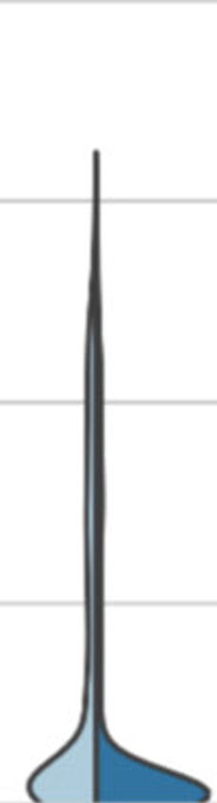


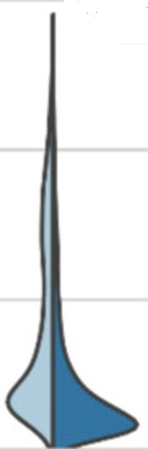


System inertia constant H
Scenario Distributed Energy: DE 2030 & DE 2040
Inertia
Inertia H [s]
Country
*source: https://www.entsoe.eu/
Notes:
NT: National Trends Scenario
GA: Global Ambitions
DE: Distributed Energy

Slide 9
Frequency Stability
NEW services
Containing the effect of a grid disturbance – balance market
FFR
FCR
aFRR
Market
Inertial
Response
Time [s]
50Hz
0.05
0.5
2
30
900
ROCOF
ROCOF
Grid

Slide 10
Role of Grid Forming Battery Systems
Grid Stability Support
Grid Forming BESS
Frequency Stability
Virtual Inertial response
5msec
Fast Frequency response
0.5 sec
Rotor-angle
Stability
Maintain synchronism
Restore after faults (transient stability)
Voltage
Stability
Reactive current
3 times 10s,10ms
HVRT in low SCR conditions
130% overvoltage
Resonance
Stability
Wideband oscillation
suppression
0.1 - 100Hz
System
Restoration
Islanding capability
Black start
In several minutes

Slide 11
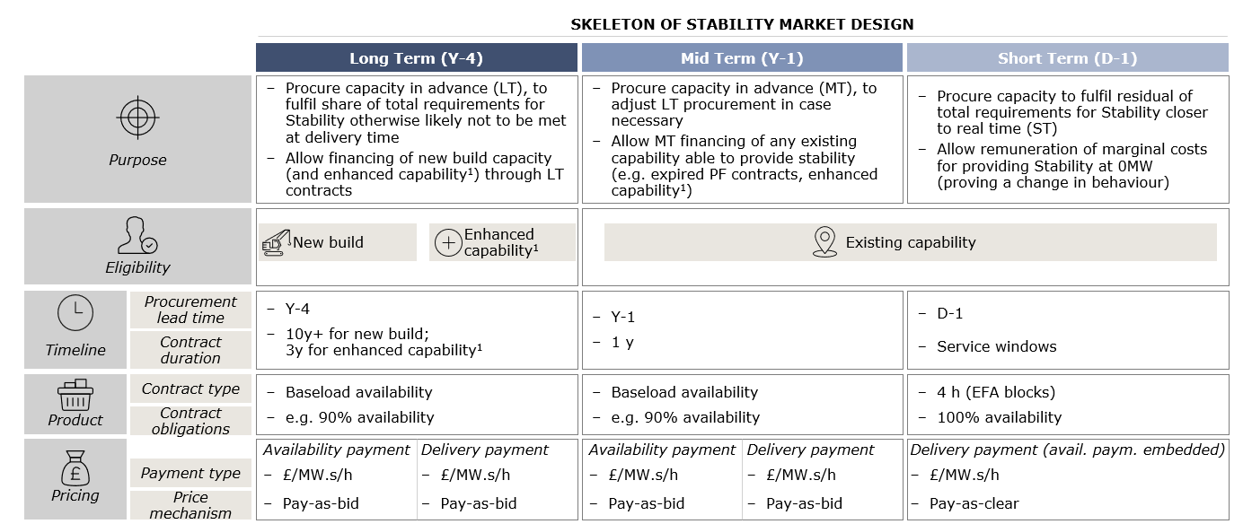
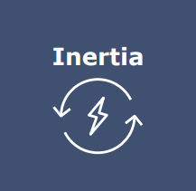


Adoption in ancillary services markets
Example: stability market design in the UK
Previously TSOs could rely on abundance of synchronous units able to provide the stability services as a by-product of energy. However with the phase out of conventional generation and dominance of RES generation, TSOs need to procure the services from new resource through a competitive market , BESS+GFM is one of them.
To slow down the rate of change of frequency (RoCoF) and allows frequency response to detect and respond to the failure.
To help maintain system voltage during a fault. SCL is regional, and is expected to decline at different rates across the country.
To help manage voltage by providing immediate, real-time adjustments to reactive power, especially in the grid dominated by renewables.

Slide 12
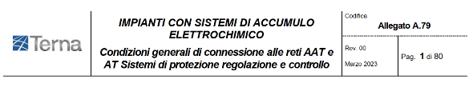

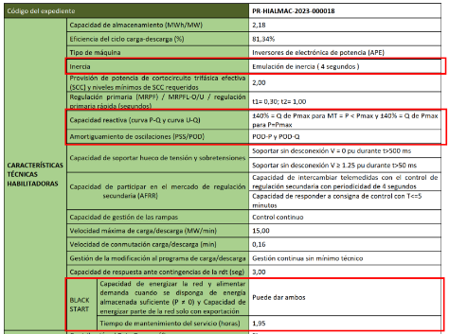
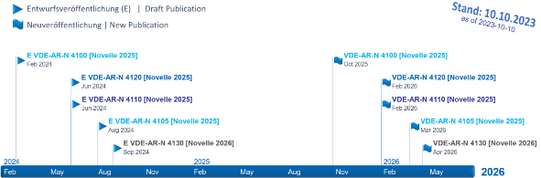
Adoption of GFM in Regulations and Standards
GFM part of Network Code:
Requirements for Generators (RfG)
Germany：2024 issued Grid forming ancillary service and develop grid codes ahead of Europe
Italy: 2023 grid code requirements
Spain: Subsidized Project Requirements
RfG2.0 will be released in 2024 and implemented in GF27.
RfG2.0: Include ESS, add RoCoF and Grid forming requirements for PPM in all scenarios of inverter systems connected to the grid: Type A, Type D, Type C, and Type D.
2024 released Grid forming ancillary service and related technical requirements
Italy：grid forming capability, including reactive power adjustment, voltage support in the case of faults, black start, inertia synthesis, and POD.
2022 | 2023 | 2024 | 2027
drafts | Public consultation | Released | GF Implementation
2024 Feb.，FNN issued《Grid forming and technical requirements for providing instantaneous inertia 》Draft
PLANTS WITH ELECTROCHEMICAL STORAGE SYSTEMS
General conditions of connection to Ultra High Voltage and High Voltage networks Protection systems regulation and control
Spain：2023 grid code requires GFM capability, including reactive power adjustment, black start, synthetic inertia, and POD.
Type C and D PPMs (Utility)
Limit transient frequency deviation
Provides additional capacity beyond the inherent ESS
POD (Power Oscillation Damping)
Type B PPMs (C&I/small Utility)
Limiting the frequency deviation
Synthetic inertia
Public consultation on the power grid code in 2024, and release and implementation in 2026
Type A PPMs (domestic/C&I)
PPM as Thevenin Voltage Source
Voltage and phase angle stability during accident
Dynamic performance related to voltage control
Continuous and stable operation when PPM current limit is reached
Ability to activate or deactivate Grid forming mode

Slide 13




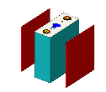



Battery Energy Storage Systems
require must more than just an Li-ion cell module…
Power electronics technology
Material
(GaN/SiC)
Component
(IGBT/MOS)
Heat dissipation
management
Energy Storage System
Electrochemical technology
Cell Quality Control &
Test Standard
Grid
Connection
Energy storage
management
Digital: IT/OT/IoT
Sensing
(Digital/Visual)
Connection
(IoT)
Control
(Chip/Algorithm),
BMS, EMS, SCADA

Slide 14
Summary and conclusions
Grid Forming is a necessary technology as to facilitate the transition of the energy system to enable a large share or renewables in the mix.
It allows for Inverter-based systems, including BESS, to take similar grid supporting behavior as the conventional thermal generators
It provides virtual inertia and other grid stability capabilities
Standards and regulations are well under way and is being adopted in the field in various countries
BESS can turn imbalance effects in energy markets into commercial opportunity: peak shifting and arbitrage
Battery can be combined with PV (Hybrid PV+BESS) to optimize return in solar
There is the opportunity to capture revenue in merchant markets from new ancillary services
Investors in BESS to manage an application stack combining products from energy and capacity markets.

